Slide 1

Data Acquisition and Data Wrangling
Debasis Panda
GitHub: https://github.com/Deb052024/Data-Wranglling

Slide 2
Flow of Data Wrangling Case
Problem Overview
Attribute Explanation
Tasks on Case Study
Data Acquisition & Wrangling
Different Methods and Approaches
Scenario Building, Interpretation and Conclusion

Slide 3
Problem Overview
There are 3 different data sets
These data sets need to be acquired
Data Set 1 and 2 need to be merged and the merged set need to be concatenated with Data Set 3
On these Data Set , there exists lot of ambiguity
Post removing such ambiguity, meaningful insights to be derived from the data set – Bike Ride business study

Slide 4
Attribute Information
Date= Date of Ride
season - 1 = spring, 2 = summer, 3 = fall, 4 = winter
holiday - whether the day is considered a holiday
working day - whether the day is neither a weekend nor a holiday
casual - number of non-registered user rentals initiated
registered - number of registered user rentals initiated
count - number of total rentals
Windspeed - wind speed
humidity - relative humidity
Weather :
1. Clear, Few clouds, Partly cloudy, Partly cloud
2. Mist + Cloudy, Mist + Broken clouds, Mist + Few clouds, Mist
3. Light Snow, Light Rain + Thunderstorm + Scattered clouds, Light Rain +Scattered clouds
4. Heavy Rain + Ice Pallets + Thunderstorm + Mist, Snow + Fog
temp - "feels like" temperature in Celsius

Slide 5
Tasks on the Case Study
Data acquisition
Different Methods of Data Wrangling
1. Merge Data Set
2. Identify unique value
3. Drop unnecessary columns
4. Check Dimension of Data Set
5. Check the Data type of Data Set
6. Check the data type summary
7. Treat Missing values
8. Validate the correctness of the data at the primary level if applicable
9. Different scenario building pre and post removal of outliers as well as concatenation

Slide 6
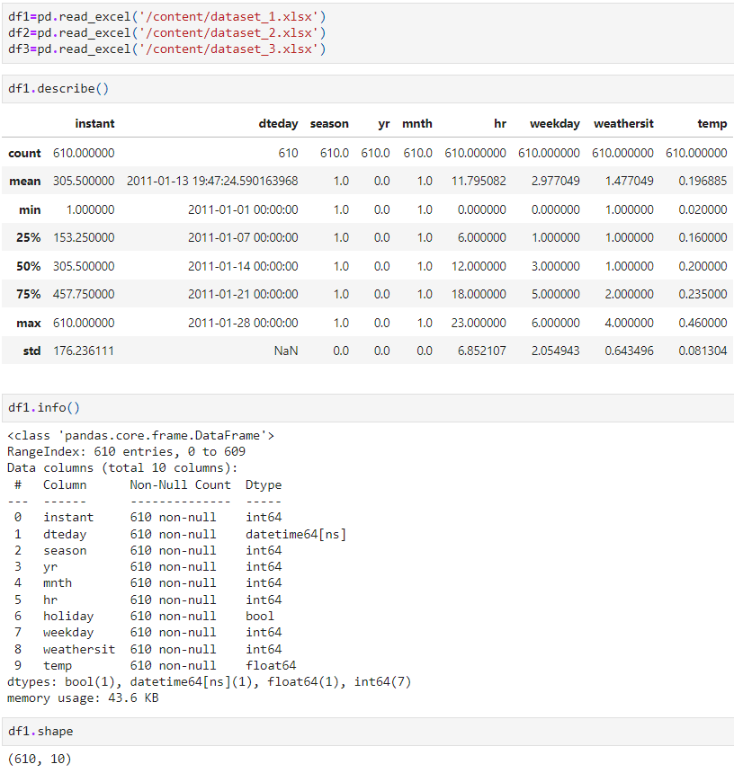
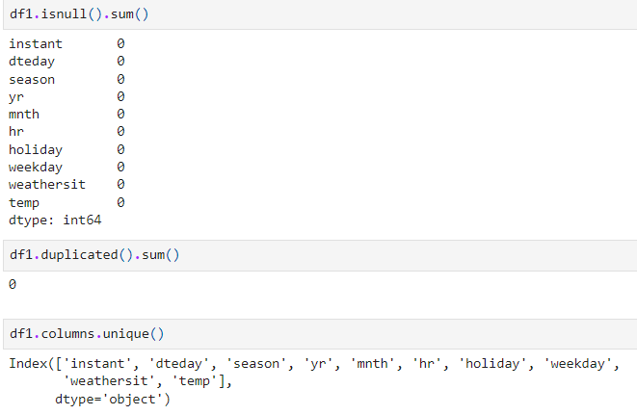
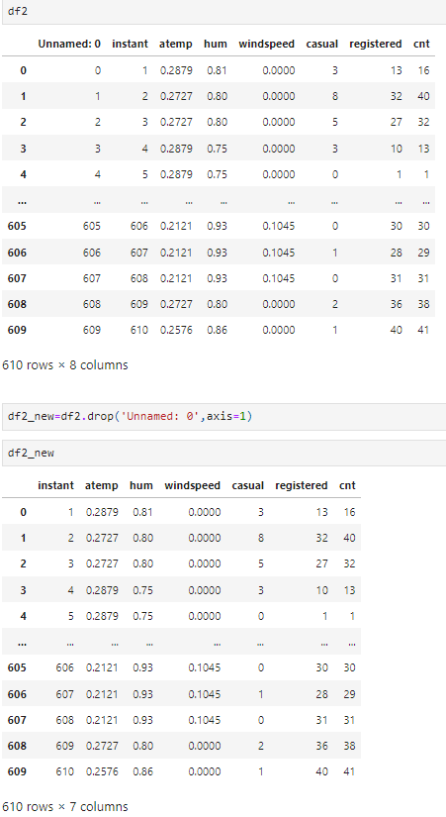
Data Acquisition and Wrangling
Data set 1,2 &3 have been acquired and assigned to Data Frame1,2&3 respectively
Data Frame 1(Df1) and (DF2) each has 610 rows and they have 10 and 7 columns respectively
No duplicate values on data Frame 1
“Unnamed” attribute has been dropped from Df2

Slide 7
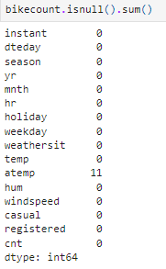
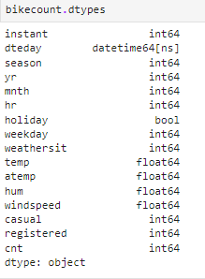
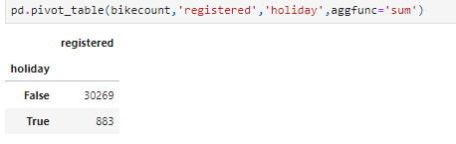
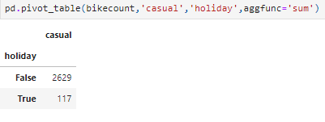
Data Wrangling –Stage-2
Df1 and2 were merged using inner join and assigned to Bike Count
There were 11 null values found on Bike Count and were replaced using “Mean”
Data Types of each of the attributes were found
“Holiday”, “dteday” attributes were of bool and datetime, rest attributes were either integer or float
Maximum Registered users on Non Holiday utilizes the service as per pivot Table

Slide 8
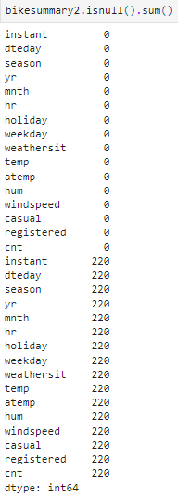

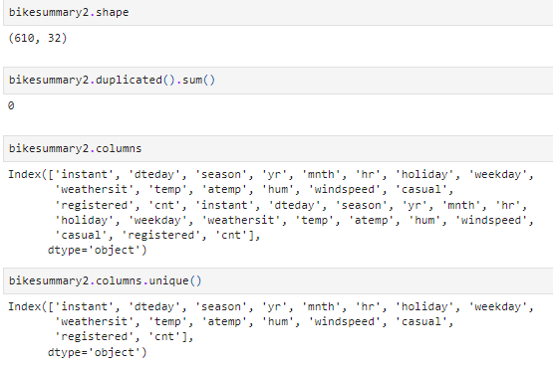
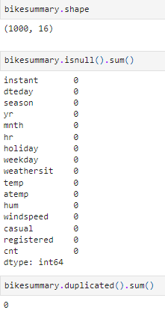
Data Wrangling-Stage3-Concatenation
Vertical concatenation with huge null values and duplicate columns,
Horizontal concatenation leads to no null and duplicates, hence horizontal approach selected
Vertical concatenation leads to 610 rows and 32 columns
Horizontal concatenation leads to 1000 rows and 16 columns

Slide 9
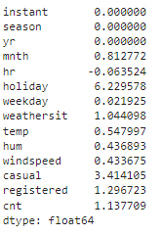
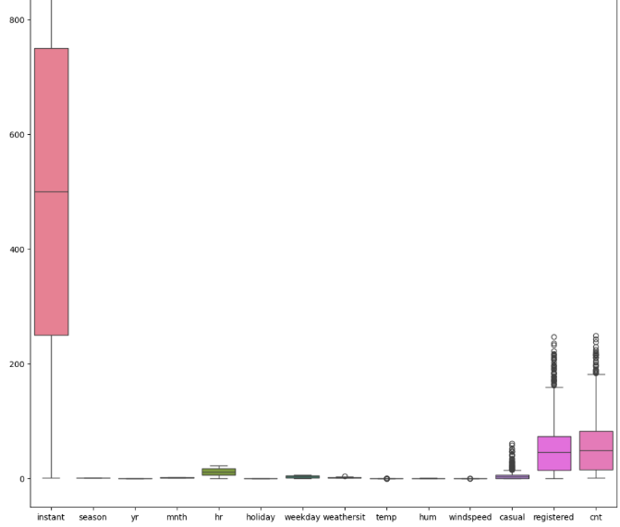
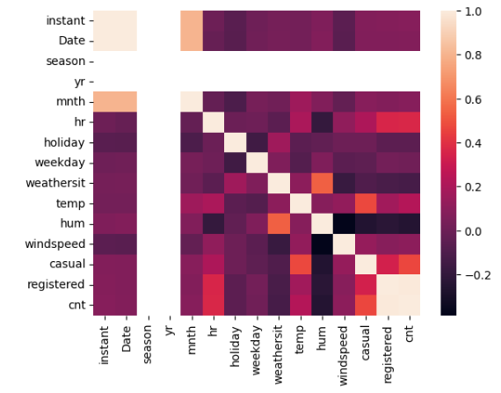
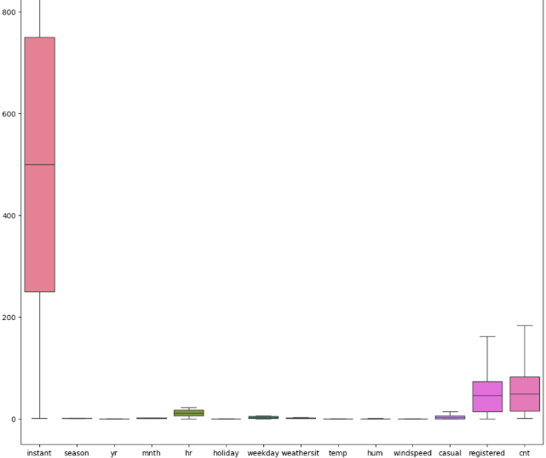
Data Wrangling-Stage4-Outlier Treatment, Skewness and Corrleation
Skewness
Outliers have been treated for each attribute and scenarios have been monitored
Correlation-Heat Map
“Atemp” variable has been dropped
“dteday” has been renamed to “Date”
Maximum skewness found on “Holiday” followed by “casual”
“Season” and “Yr” attribute having no correlation with any other attribute
Out Lier Treatment

Slide 10
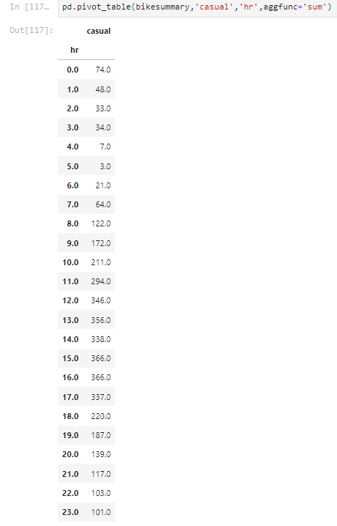
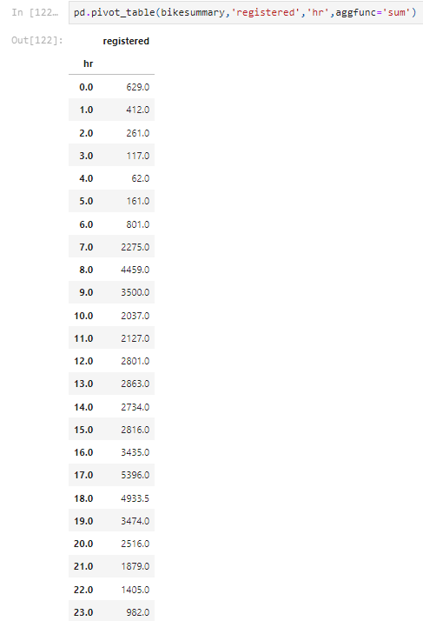
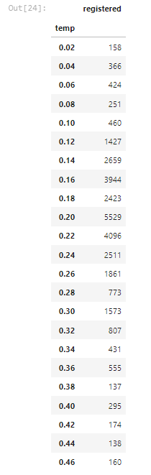
Scenario Interpretation and Conclusion
Post concatenation and outlier treatment, the upper and lower caps have been defined for each of the attributes
Maximum hrs spent by casual users can be converted to Registered
Less hrs(less than median hrs 12hr) spent by Registered users need to be approached and motivated for spending more hrs in ride
More than 12 hrs spent registered users need to be approached for testimonials and their utility under different conditions need to be understood
Under the median temperature range between 0.16 to .24 maximum registered users go for a ride

Slide 11
THANK YOU

